Slide 1
Pedibus Development
April 17, 2014
Sponsored by Capital City Pedicab Company
In affiliation with the FSU and FAMU College of Engineering
Team 18:
Onyewuchi Ebere
Andrew Galan
John Hassler
James McCord
Sponsor: Instructor:
Ron Goldstein Dr. Kamal Amin
Faculty Advisors:
Dr. Patrick Hollis

Slide 2
Executive Summary
The development of the Pedibus surrounded the idea to provide an eco-friendly and environmentally safe traveling entertainment vehicle to attract people of all ages and professions.
Our goal: Build and design a fully-operating pedibus prototype that will be used as a guide for future manufacturing, reproduction, and advertising purposes.
Throughout the past school year, the development has undergone a series of processes that included research, design, finance, analysis, manufacturing, and testing.
Overall Accomplishment: The fully-operating Pedibus prototype has been manufactured and tested for reliability, safety, and operation.

Slide 3
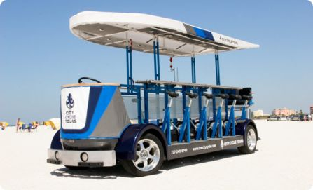
Needs Assessment
The task assigned by the sponsor, Ron Goldstein of Capital city Pedicabs, was to build an eco-friendly, pedal powered vehicle, to be used for tours and attractions throughout the city of Tallahassee.
Inspiration was provided by already exiting models, but not limited to a set configuration as the sponsor entrusted the design of the prototype to the team members.
The overall function of the Pedibus requires a comfortable cadence speed to power the central drive train based purely on pedal inertia.

Slide 4
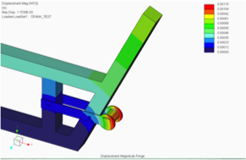
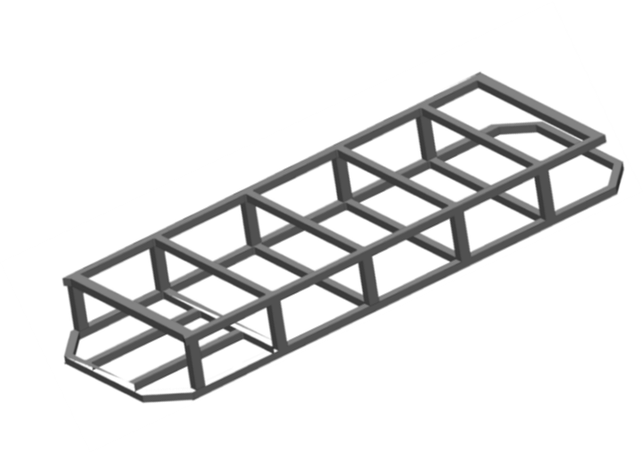
Design Process
The structural design and dynamic analysis of the Pedibus prototype was the main focus during the fall semester.
The initial design and selection was broken down into three stages:
Structural Frame
Steering and Braking
Power Generation and Efficiency
Several designs were presented that allowed for a variation of models to be considered. The final design to be manufactured was decided by both the sponsor and the team members.

Slide 5
Structural Frame Selection
The structural frame of the Pedibus depended on three main components.
Strength of material
The materials had to be strong enough to allow for minimal deflection and maximum stress when applied to heavy loads.
Weight of material
The weight of the material had to be light enough so the passengers could move the Pedibus with minimal effort.
Cost of the material
The cost played a large role in the selection process of the material. There was an initial ideal budget set that had to be followed which limited the selection of some materials.

Slide 6
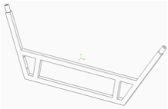
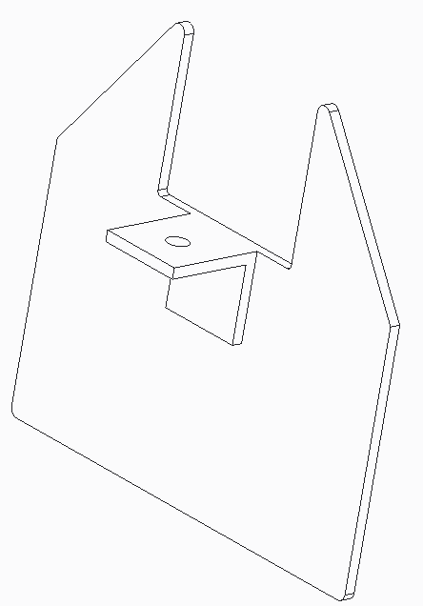
Structural Frame Design
The structural frame was chosen to be made out of both aluminum and steel.
This combination of bottom steel supports and aluminum cross members promoted a weight reduction of about 260 lbs. in comparison to an all steel frame.
The aluminum cross members still provided enough stability and support to absorb the downward force produced by each individual passenger.
The cross members were attached to the steel support beams by custom made brackets that limited any potential movement.

Slide 7
Drive Train Design Selection
Existing models use:
Cold rolled steel drive shaft
Rear axle from automobile
Differential from automobile
Question
How to connect pedals to drive shaft?
John Hassler

Slide 8
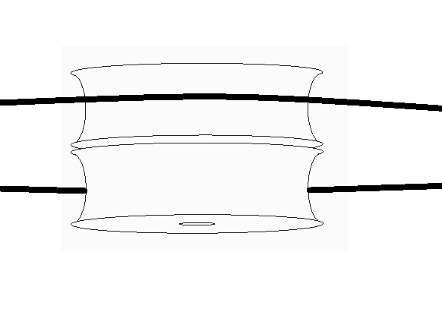
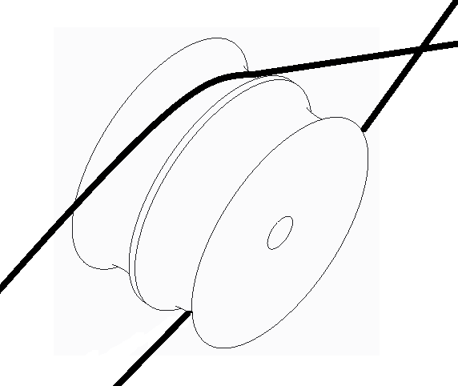
Drive Train Layout
Chains on one side crossed
Crossed chains run through pulley
Bike gears and chains installed to the right of cross member from passengers perspective
John Hassler

Slide 9
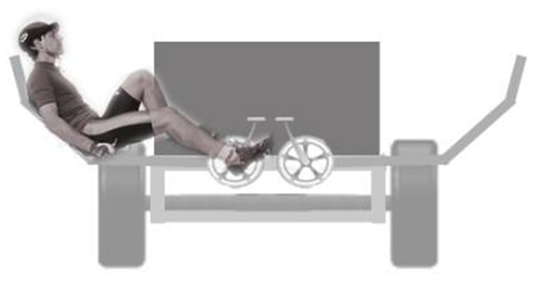
Peddling station Design
Design # 1 – Standard bicycle peddling station
Pros:
Higher viewing angle better for scenic tours
Seated at a table (more social, able to drink or eat)
Peddling is similar to traditional bike orientation
Cons:
Capable of generating less total power
less comfort on long rides due to lack of back support
Design # 2 – Recumbent peddling station
Pros:
Capable of generating more power per peddling station
Seating is comfortable for long periods of time
Cons:
Lower viewing angle
Seating is less conducive to social interaction
Smaller populace capable of powering the peddling station
Head is in unsafe position
John Hassler

Slide 10
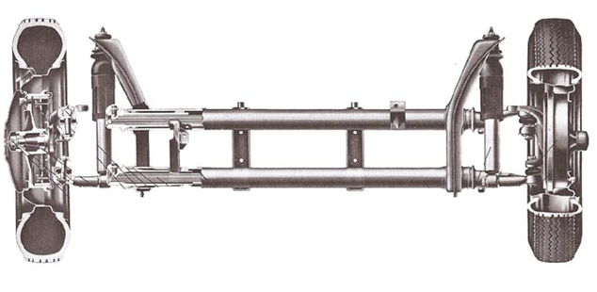
Steering and Braking Selection
Chose rack and pinion steering and hydraulic disc brakes early in the fall semester.
Entertained the idea of using a VW beetle front end to simplify the manufacturing process.
Ultimately decided on a mustang II independent front suspension kit that encompassed braking, steering, and suspension.

Slide 11
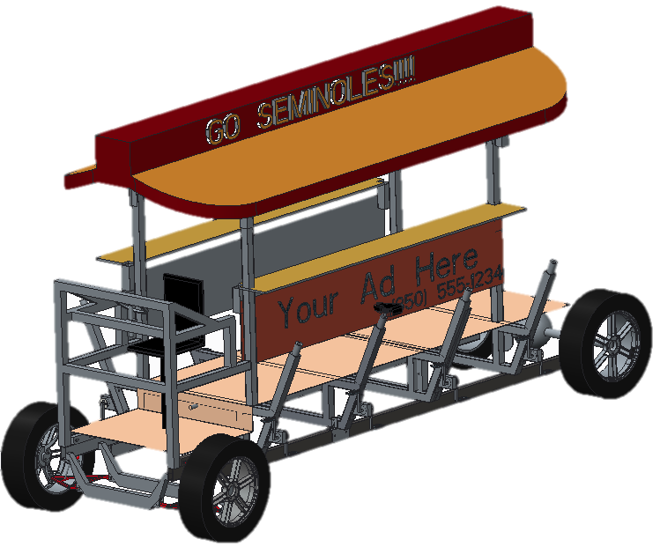
Final Design
The Pedibus will include:
8 passenger pedaling stations.
1 driver station located at the front
Manual rack and pinion steering
Front hydraulic disc brakes
Additional room for standing passengers.
An estimated maximum speed of 7 mph.
Independent front suspension
Adjustable seat and bar height
Easy maintenance
An enjoyable atmosphere

Slide 12
Behind The Scenes Videos

Slide 13
Encountered Problems
Due to the original storage space no longer being available, a new location had to be found.
The assembly is now being performed in the machine shop located on campus.
The front end suspension components that were delivered as a set did not configure with one another and thus delayed the installation process.
Overcoming the poor customer service by the company and with the assistance of the men in the machine shop, the front end was able to be assembled and welded to the frame.
The rear differential and steering also provided a delay in the current progress.
Alternative solutions have been found for both issues and have been resolved.

Slide 14
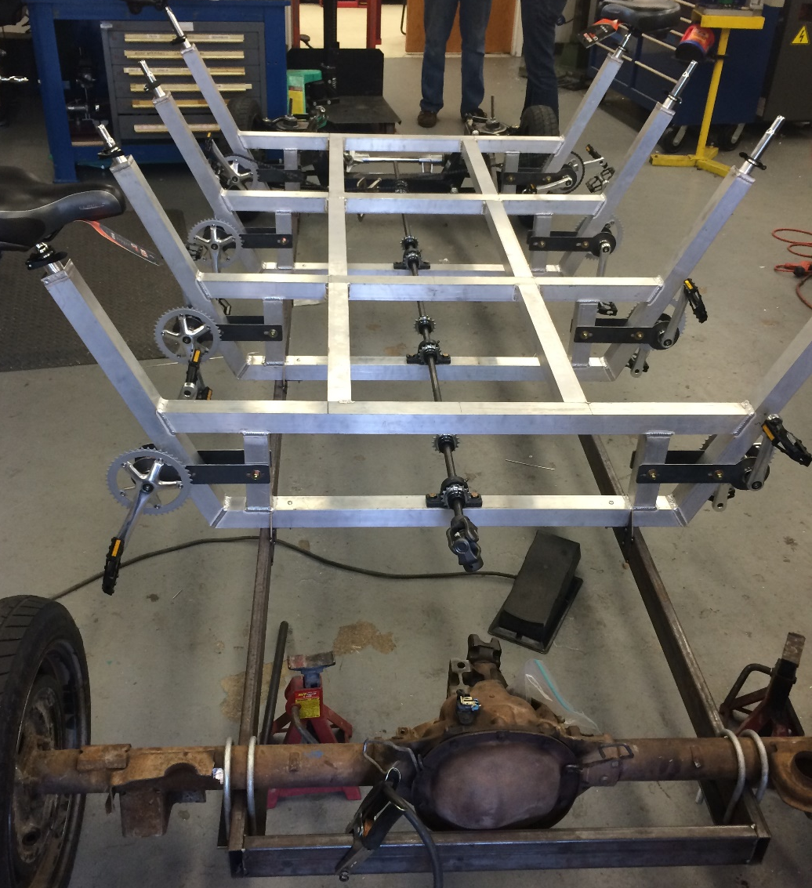
Structural Frame Design Changes
Finite Element Analysis performed on the structural frame only included forces related to static load.
The original analysis did not account for forces acting on the frame when the vehicle makes a hard stop, a passenger leans over, etc…
Added additional aluminum connecting all the crossmembers to add rigidity to the frame

Slide 15
Rear Differential Connection Design Changes
Original design required that spacers be placed between the rear axle and the steel supports so that the drive shaft would line up with the rear differential.
This caused issues with ground clearance and required meticulous placement so that the drive shaft lined up perfectly with the rear axle.
A high torque ujoint was used to correct the offset between the rear differential and the drive shaft.

Slide 16
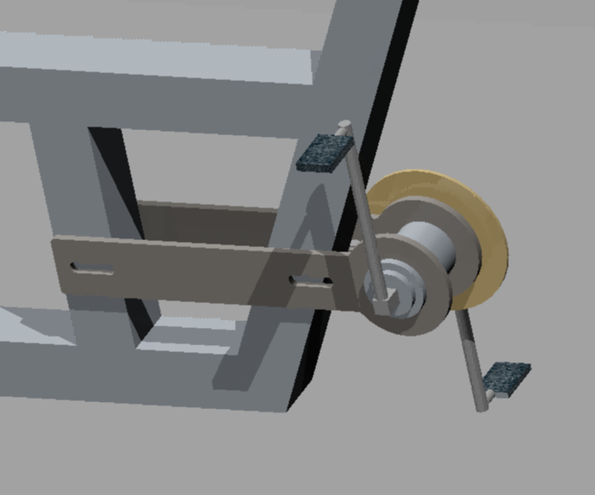
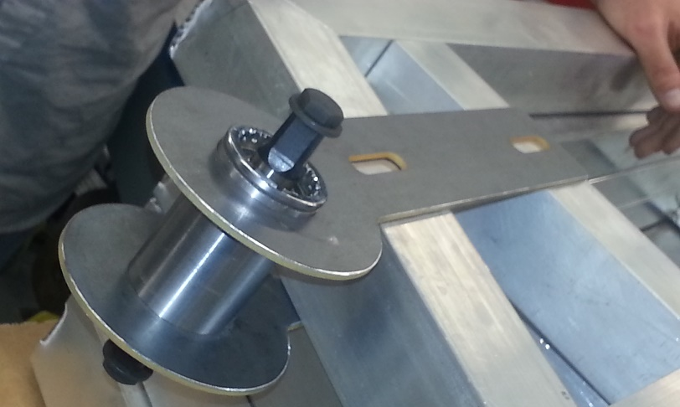
Pedal crank design changes
As the pedibus is used the chains will stretch.
Some mechanism had to be included so the tension of the chain could be adjusted.
A new pedal crank design was chosen to make this possible.

Slide 17
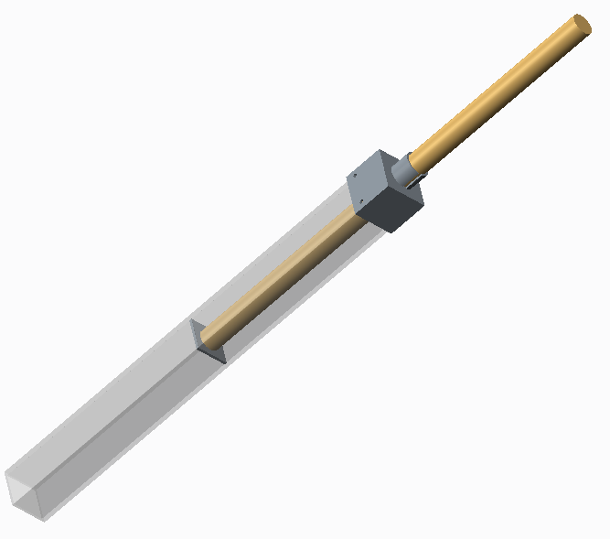
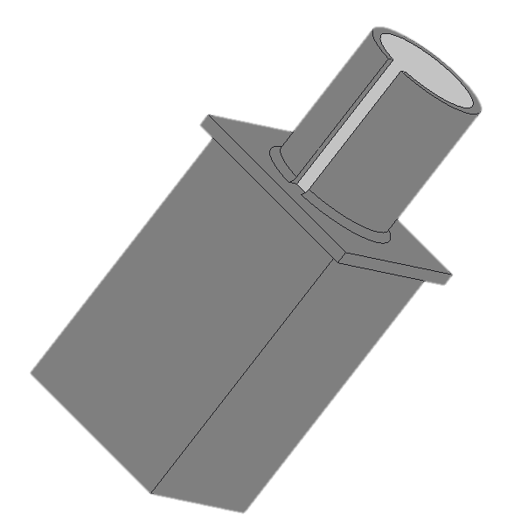
Seat post collar design changes
The seat post collar went through many design iterations.
The final seat post collar was milled form a solid billet of aluminum.
It is the most meticulously machined part on the pedibus.
Old Design
New Design

Slide 18
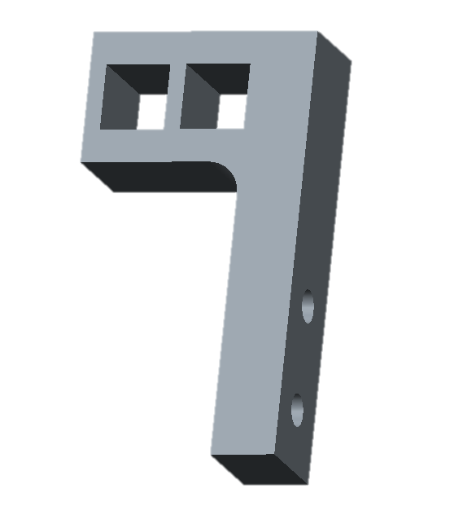
Crossed Chain Separator Design Changes
The team tried several different separator designs.
Two separate pulleys
Single double pulleys
Derailleur gears
Nilon separator
There is difficulty keeping the chain on the sprocket when its angle of deflection is increased
Ultimately chose to use a delron block with guides cut out for both sides of the chain

Slide 19
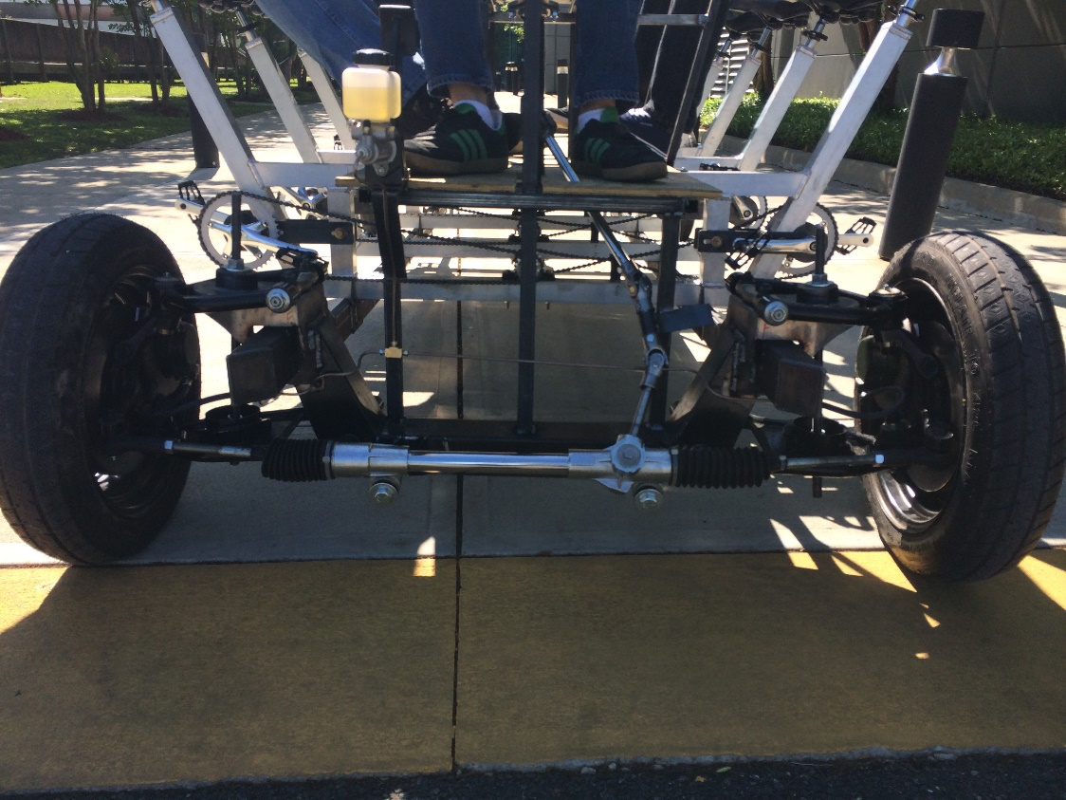
Removal Of Front End Suspension
The company we ordered the mustang II IFS front end kit from took two months to ship us all the parts
After all the parts were shipped it was discovered that the shocks included with the kit were not the correct shocks.
Due to time constraints the suspension was removed and a threaded rod was bolted in place so assembly could proceed.

Slide 20
Steps In Assembly
Connected rear end to steel supports
Connected front end to steel supports
Attached aluminum cross members to steel supports
Assembled and attached bike parts
Assembled drive shaft and connected bike parts and rear differential
Installed walking platform
Installed brakes, steering, and driver seat
Installed handlebars

Slide 21
Future Recommendations
Use a cheaper commercial front end or design one.
A Mazda Miada front end has been recommended as a replacement for the Mustang II because of its simplicity and low cost.
Construct an all steel structural frame instead of a steel and aluminum combination.
The savings in weight were defeated by the increased complexity in manufacturing
Implement a method for changing gear ratio.
Max speed is currently limited by pedaling cadence not by power requirement.
Andrew Galan

Slide 22
Budget
BOM |  | # | Price Per Item |  |  | BOM |  | # | Price Per Item
Steel Frame |  | 1 | $250.00 | $250.00 |  | Rear Axle U-Joint |  | 1 | $81.00 | $81.00
Aluminum Frame |  | 1 | $459.00 | $459.00 |  | 2 U Joint Steering Shaft |  | 1 | $170.00 | $170.00
Pillow Blocks |  | 4 | $30.00 | $120.00 |  | Additional steering Ujoint |  | 1 | $45.63 | $45.63
3/4 inch Cold Rolled Drive Shaft |  | 1 | $100.00 | $100.00 |  | U Bolts |  | 4 | $14.00 | $56.00
Mustang II Ifs |  | 1 | $1,350.00 | $1,350.00 |  | Brake Pedal and Master cylinder |  | 1 | $133.00 | $133.00
Rear Axle and Differential |  | 1 | $140.00 | $140.00 |  | Bottom Bracket Shell |  | 8 | $4.25 | $34.00
Camaro drive shaft |  | 1 | $48.00 | $48.00 |  | Seat post clamps |  | 8 | $8.00 | $64.00
Bike Crank |  | 8 | $45.00 | $360.00 |  | Aluminum Billet |  | 1 | $59.54 | $59.54
Bike Seat |  | 8 | $17.00 | $136.00 |  | Steel round stock |  | 1 | $48.00 | $48.00
Bike Chain |  | 8 | $30.00 | $240.00 |  | brake lines and fluid |  | 1 | $55.00 | $55.00
Free Wheel gear |  | 8 | $25.00 | $200.00 |  | Steel Plate |  | 2 | $45.54 | $91.08
Wheels & Tires |  | 4 | $17.00 | $68.00 |  | nuts, bolts, lugs, degreaser |  | 1 | $68.30 | $68.30
 |  |  |  |  |  | Total |  |  |  | $4,376.55

Slide 23
Conclusion
The design and construction of the Pedibus has taken the entire time provided by these last two semesters and required the removal of several desirable components.
Many of the original designs didn’t work and had to be redesigned.
The assembled pedibus prototype was a success with a top speed of ~5mph and can be powered by a single passenger.
We encourage Mr. Goldstein to bring the project back next year to add a power assist electric motor, lights, speakers, etc…
A special thank you to Jeremy Phillips. The machinist in the engineering school machine shop. Without Jeremy’s constant help and advice we would not have completed the project.

Slide 24
Questions
?

Slide 25
Future Demonstration
The assembly of the prototype is still under construction. Upon completion and after testing, the pedibus will be ready for demonstration.
Public demonstration will occur during the open house event hosted by the FSU Engineering department.

